Slide 2
form an OpenAPI specification implement a dumb service with fake/random data
Requirements
accept configurations for OAuth authentication (at generation time) to secure the API endpoint and provide an out of the box functionality

Slide 4

Time
Document verification can require days or even weeks to be handled. Human operators can increase the probability of errors.

Slide 5
Time
Document verification can require days or even weeks to be handled. Human operators can increase the probability of errors.
Physical archives
Falsification

Slide 6
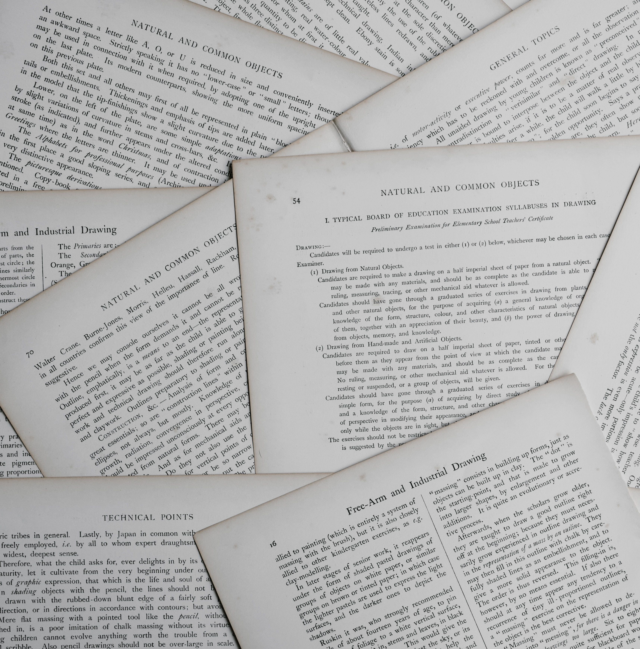
Time
Physical archives
Too much paper for something that can be digitalized. Searching through thousand papers is not pleasant at all.
Falsification

Slide 7

Time
Physical archives
Falsification
Physical documents can be easily forged and difficult to verify. Digital ones needs to be signed with difficult to use algorithms.

Slide 8

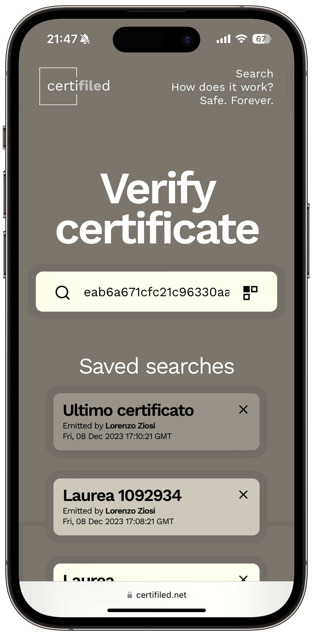

ZDell

Slide 9
ZDell
Blockchain-based platform to handle and safely store digital certificates, with fast and easy to use verification.

Slide 10
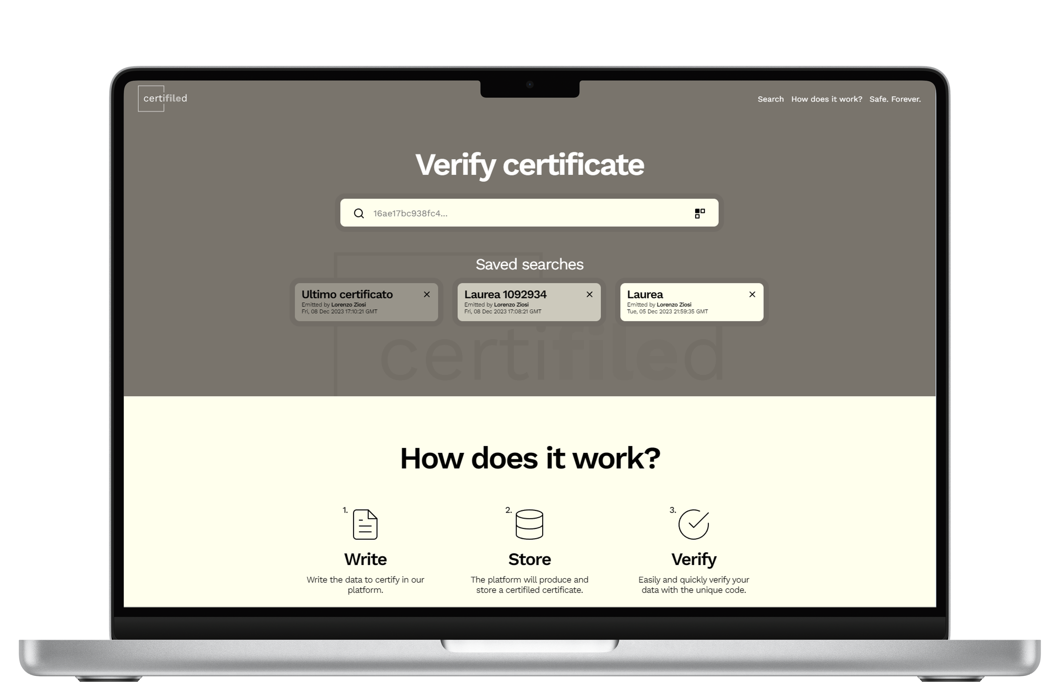
Time
2 minutes
Time required to insert a new certifiled certificate.
Physical archives
100% digital
Falsification
Tamper-proof

Slide 11
Time
2 minutes
Physical archives
100% digital
No paper. All digital.
Falsification
Tamper-proof

Slide 12
Time
2 minutes
Physical archives
100% digital
Falsification
Tamper-proof
Blockchains are safe, decentralized and immutable by nature.

Slide 13



How does it work?
1.
2.
3.
Write
Store
Verify
Write the data to certify in our platform.
The platform will produce and store a certifiled certificate.
Easily and quickly verify your data with the unique code.
Three steps, infinite gain.

Slide 14

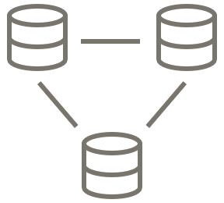

Safe.
Forever.
Blockchain based
IPFS storage
No SPOF
Hashes of the data are permantly stored in blockchain.
The data itself is stored in the Inter Planetary File System.
No single point of failure. Your data will be available even in the worst-case scenario.

Slide 15
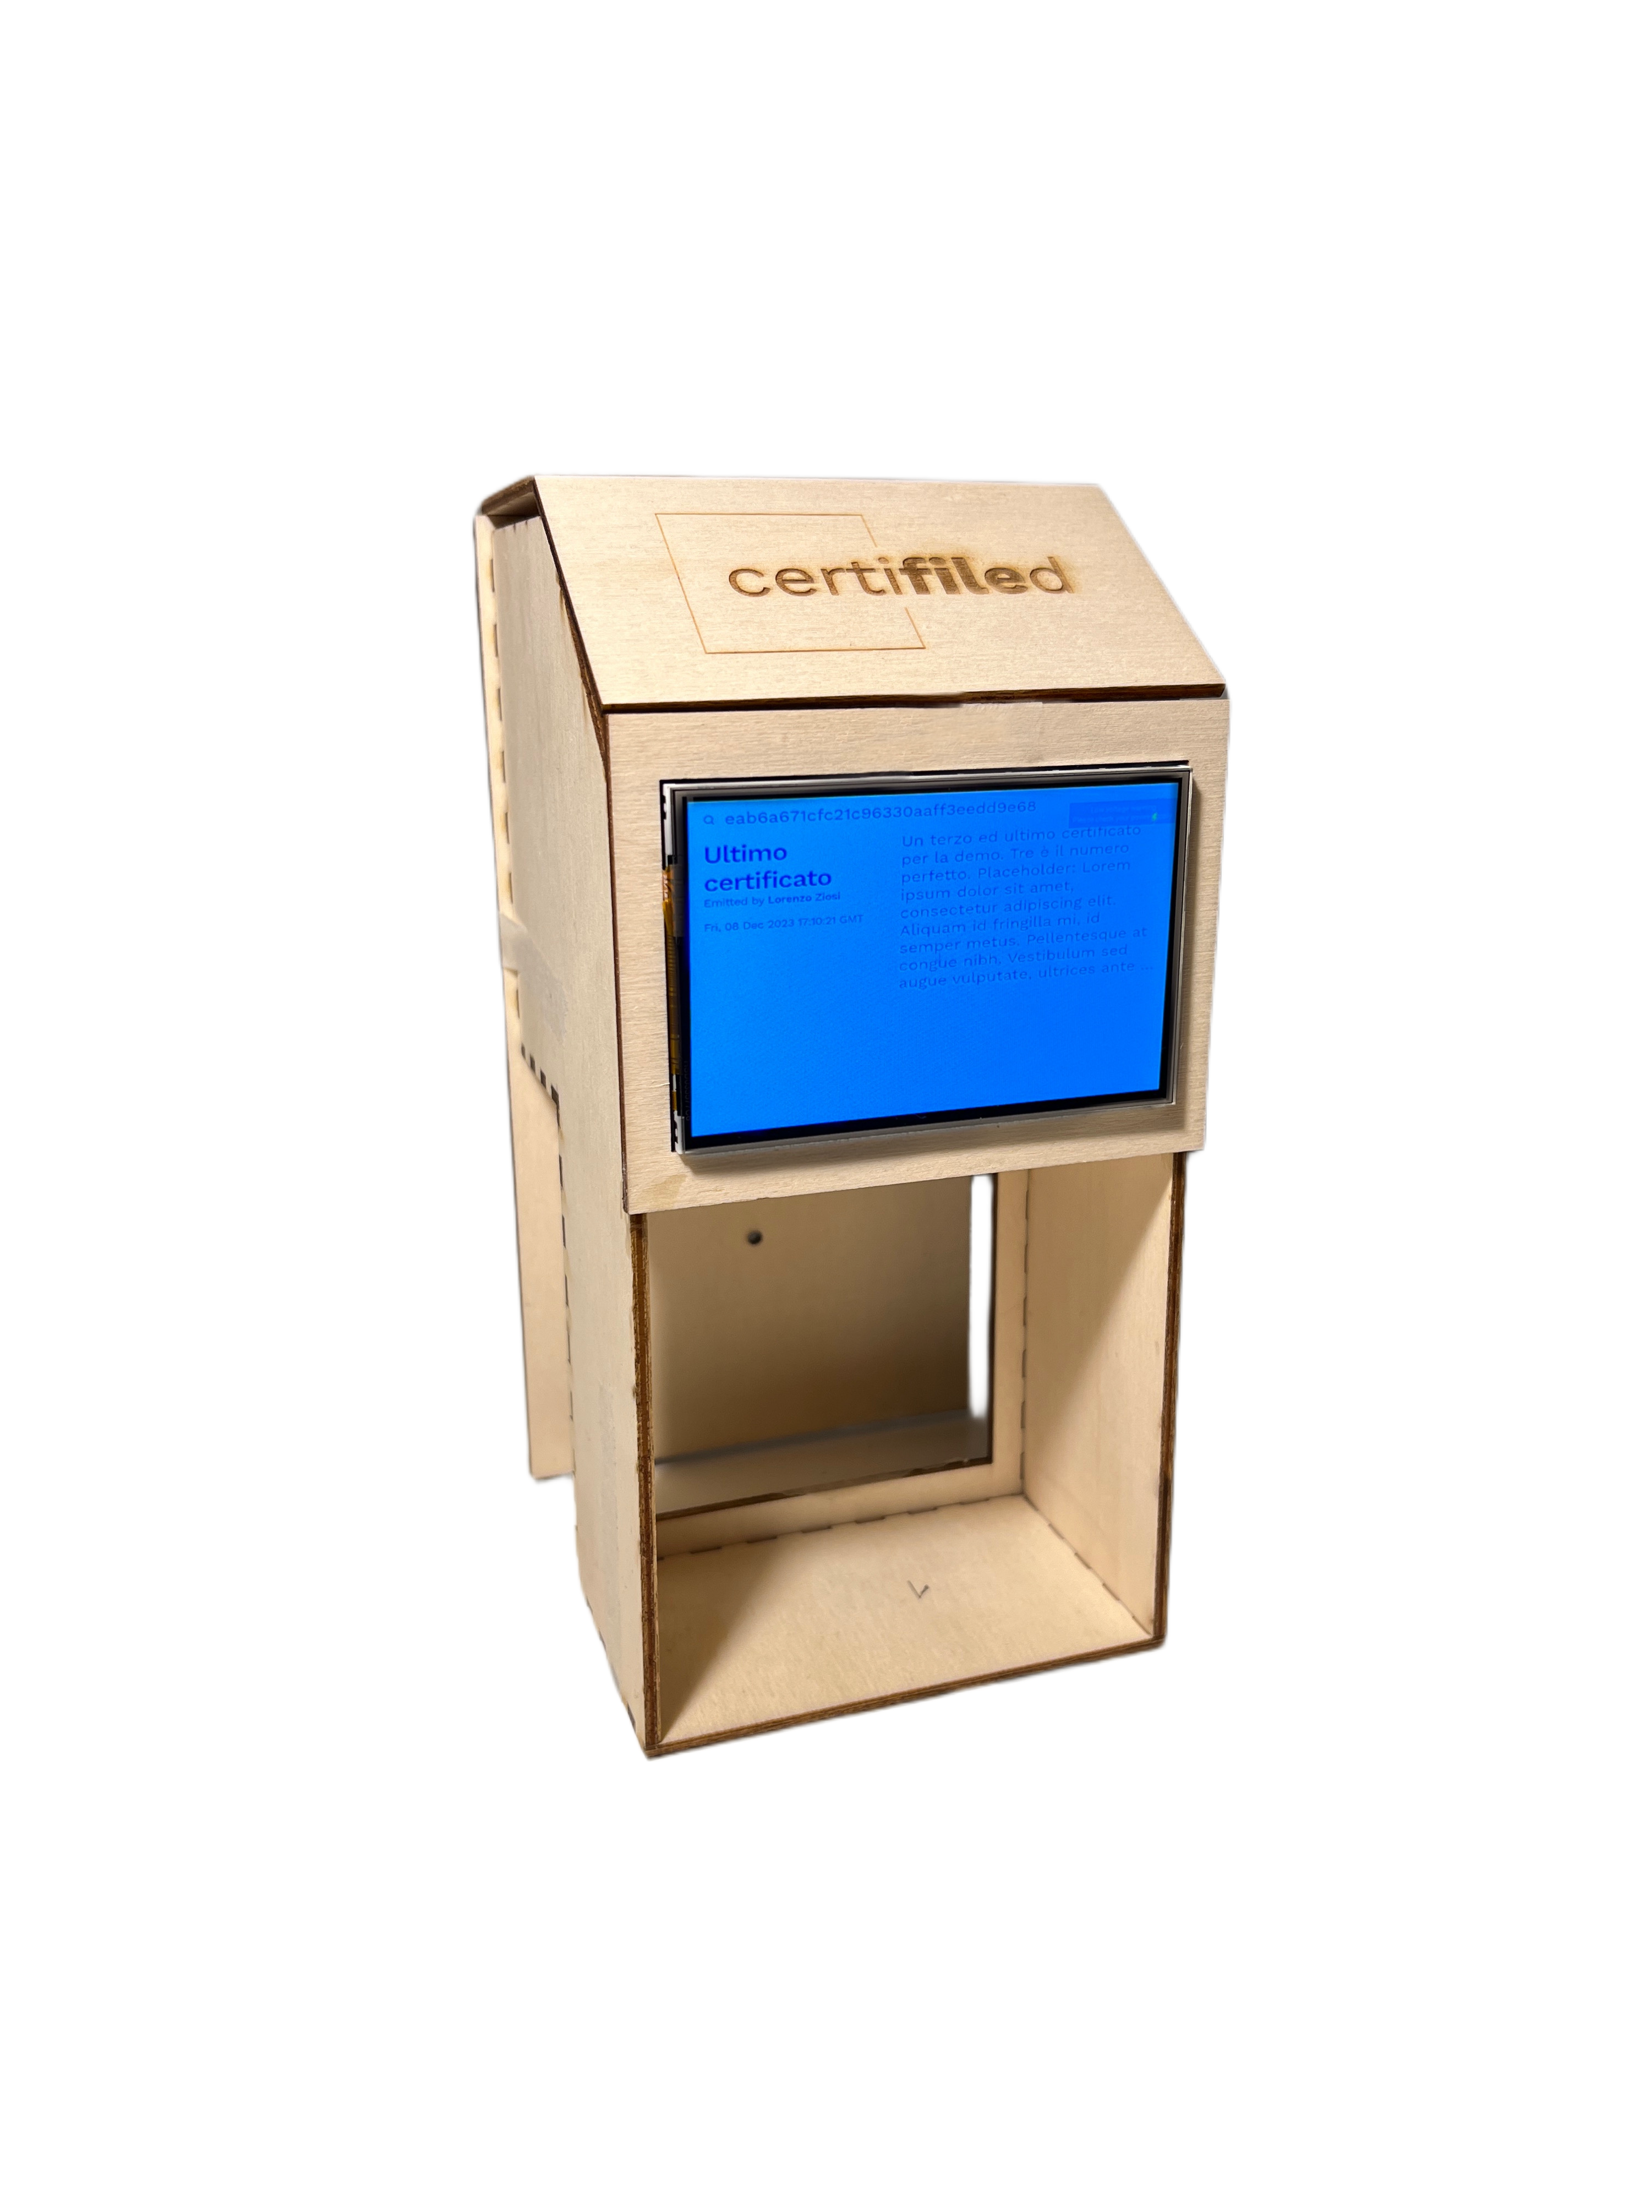
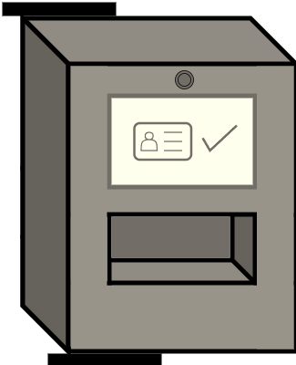



Customizable device
Suitable for everything.
QR reader
Face recognition
NFC
And much more...

Slide 16
Certification Management System Market
+43.5%
$40.2B
+12%
Growth from 2020 to 2023
Expected market size in 2030
Expected growth by 2030 compared to 2023
Source: Polaris Market Research

Slide 17
Future developments
Q1-2 2024
Q4 2024
Strategic partners agreements
User growth
Q1 2024
Q3 2024
2025
Insertion function public release
Improved physical device
certifiled blockchain

Slide 18





ZDell team
Lorenzo Calarota
Luca Dominici
Enrico Zacchiroli
Lorenzo Ziosi
Luca Sambuchi

Slide 19
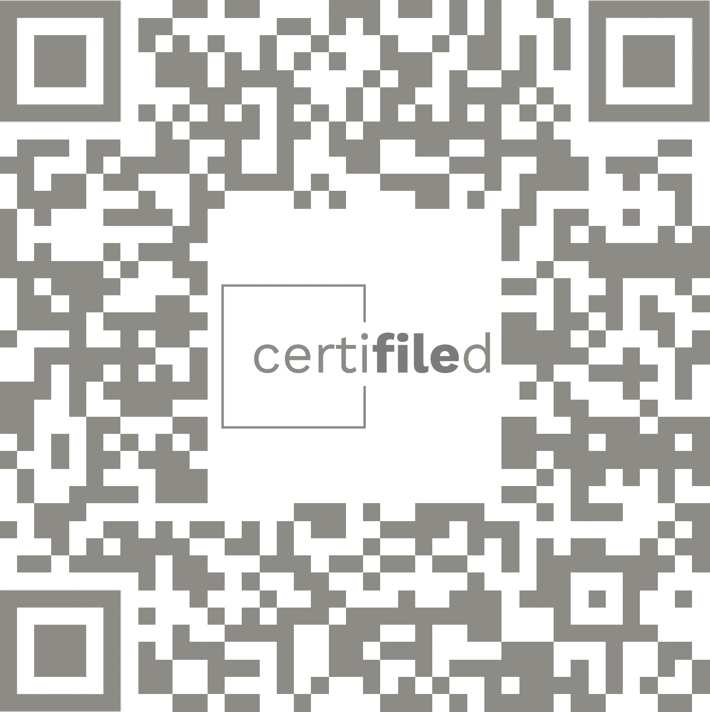
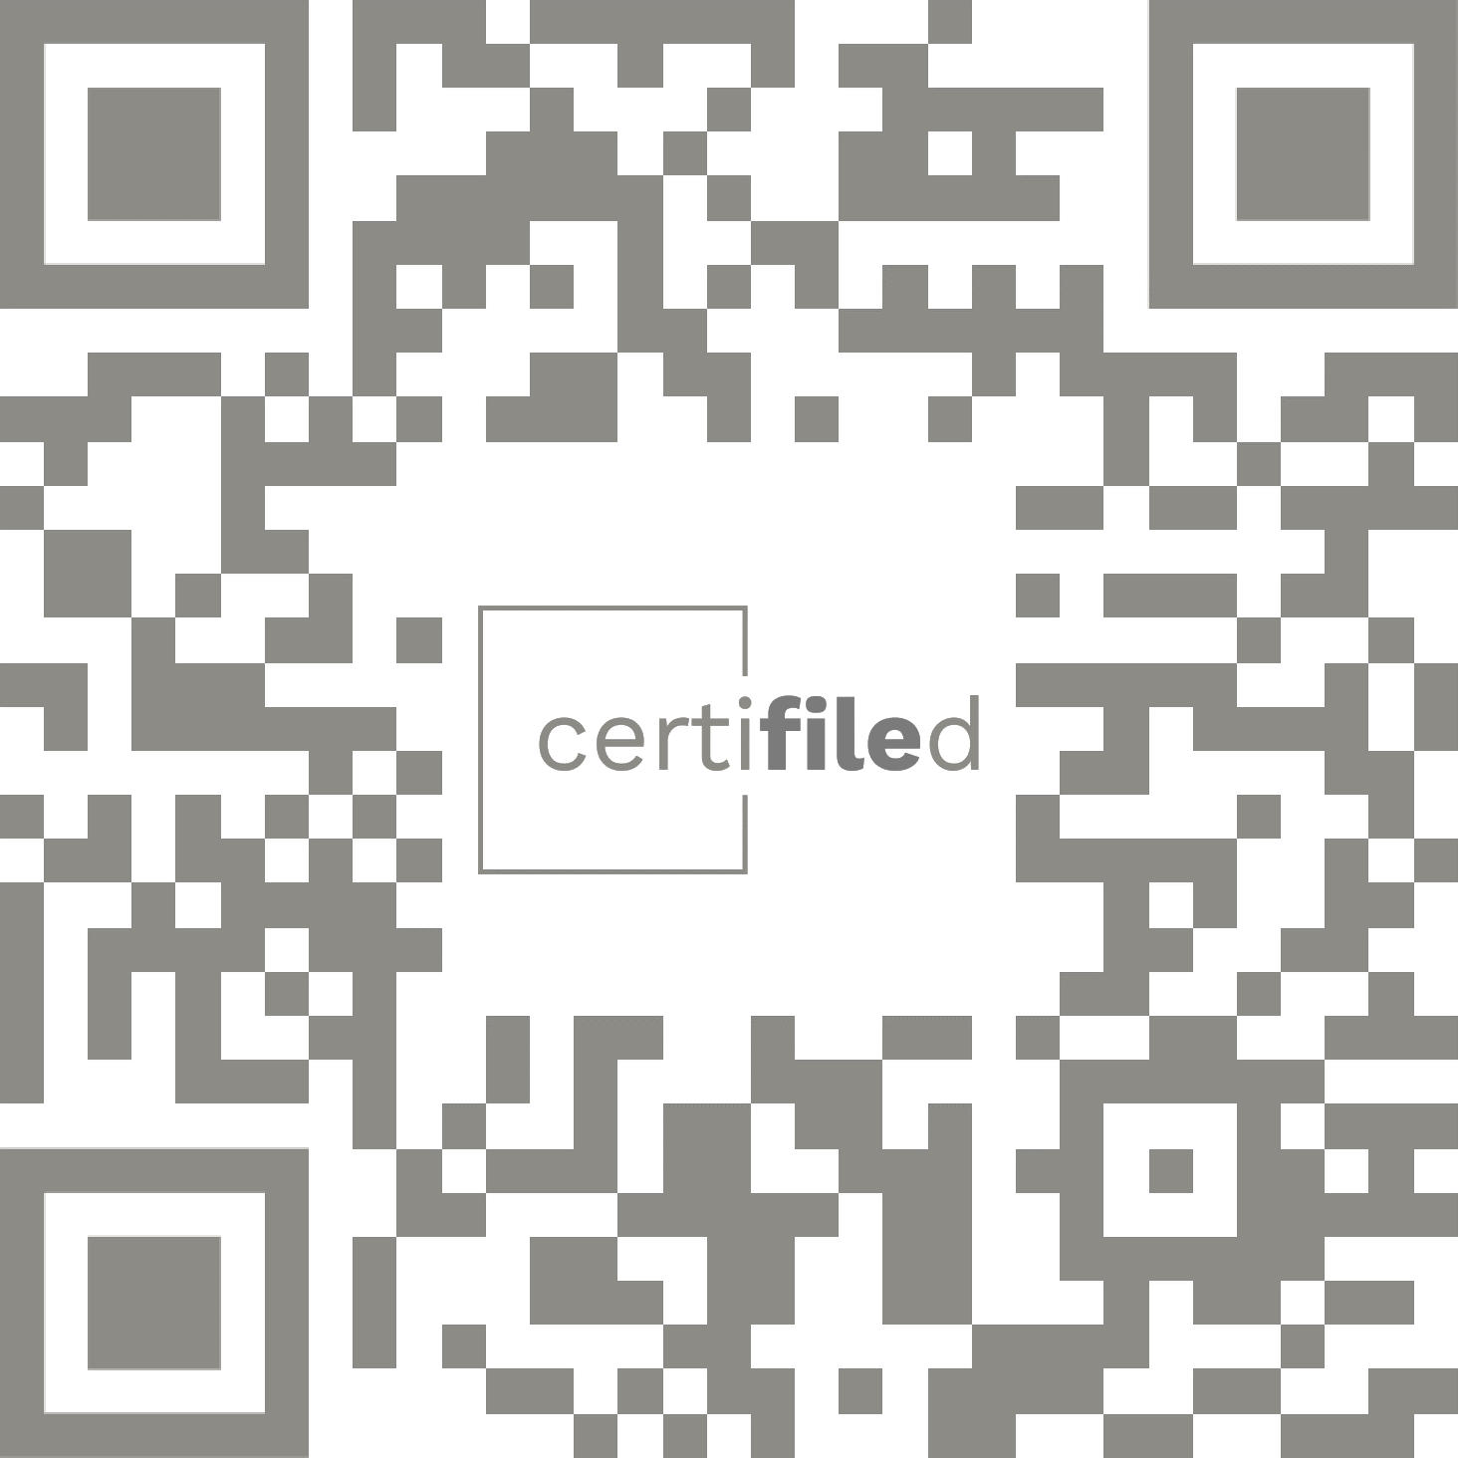
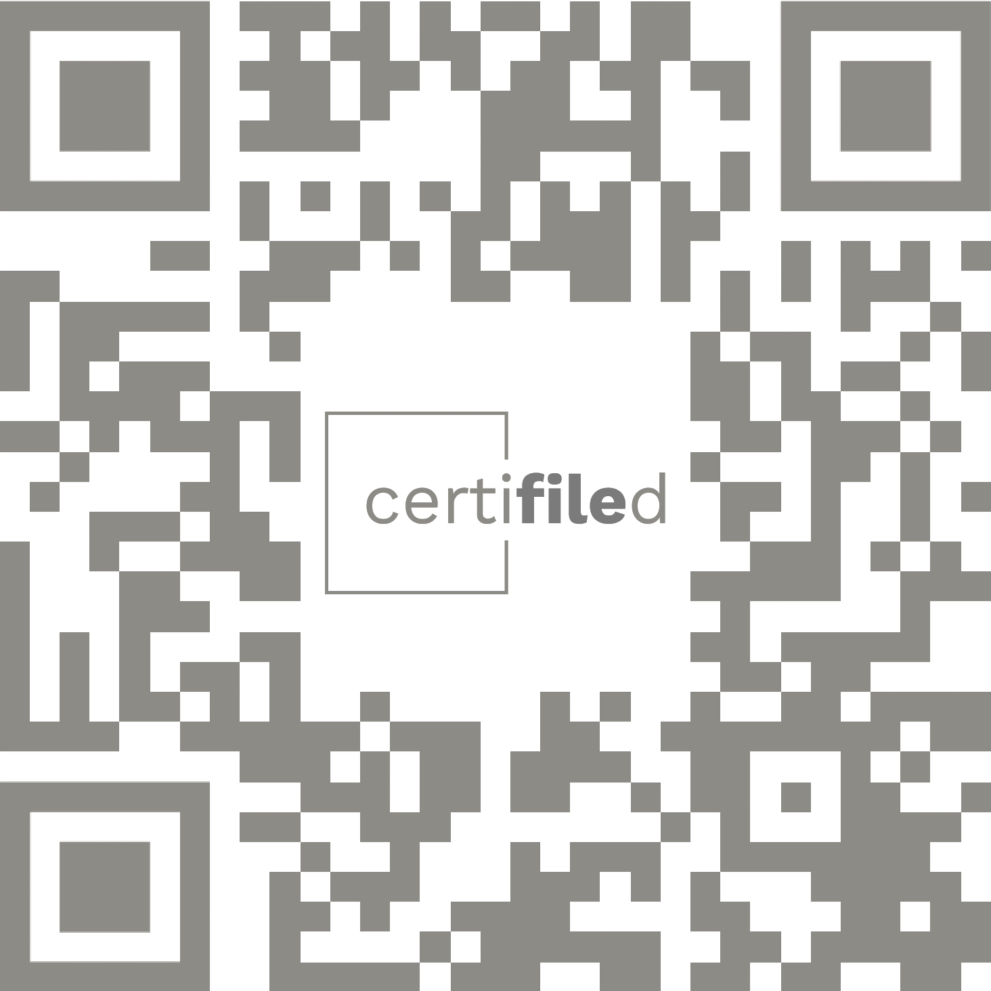

Thank you
Try yourself on certifiled.net
Certificate IDs QR codes to scan within the site

Slide 20
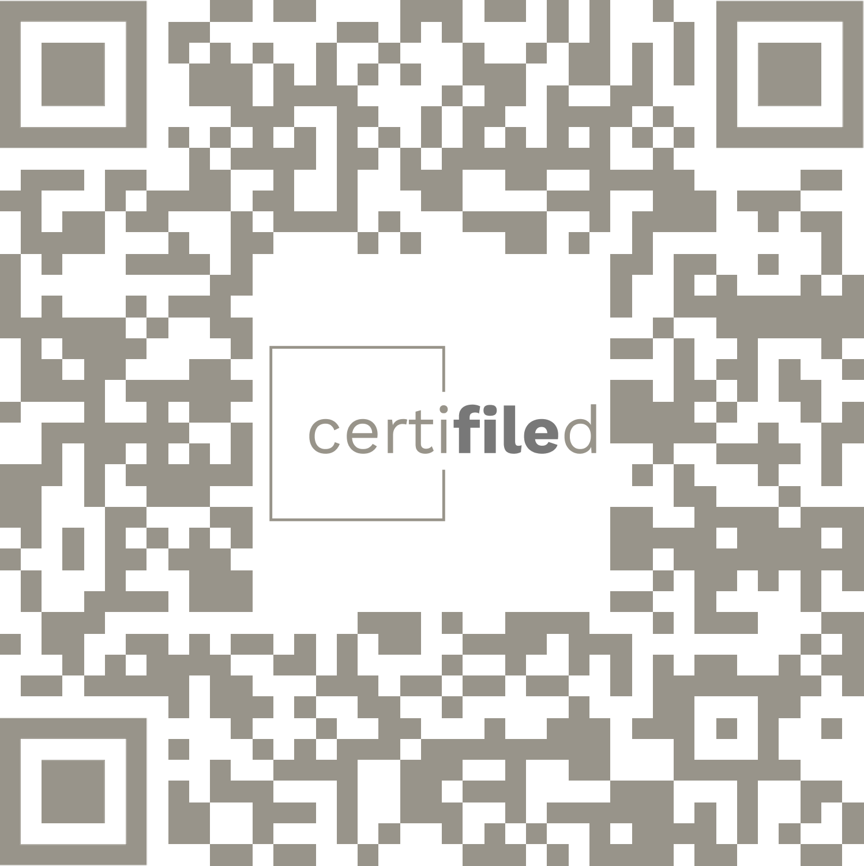



Try it yourself
Certificates QRs to scan within the website
.net
Thank
You

Slide 21
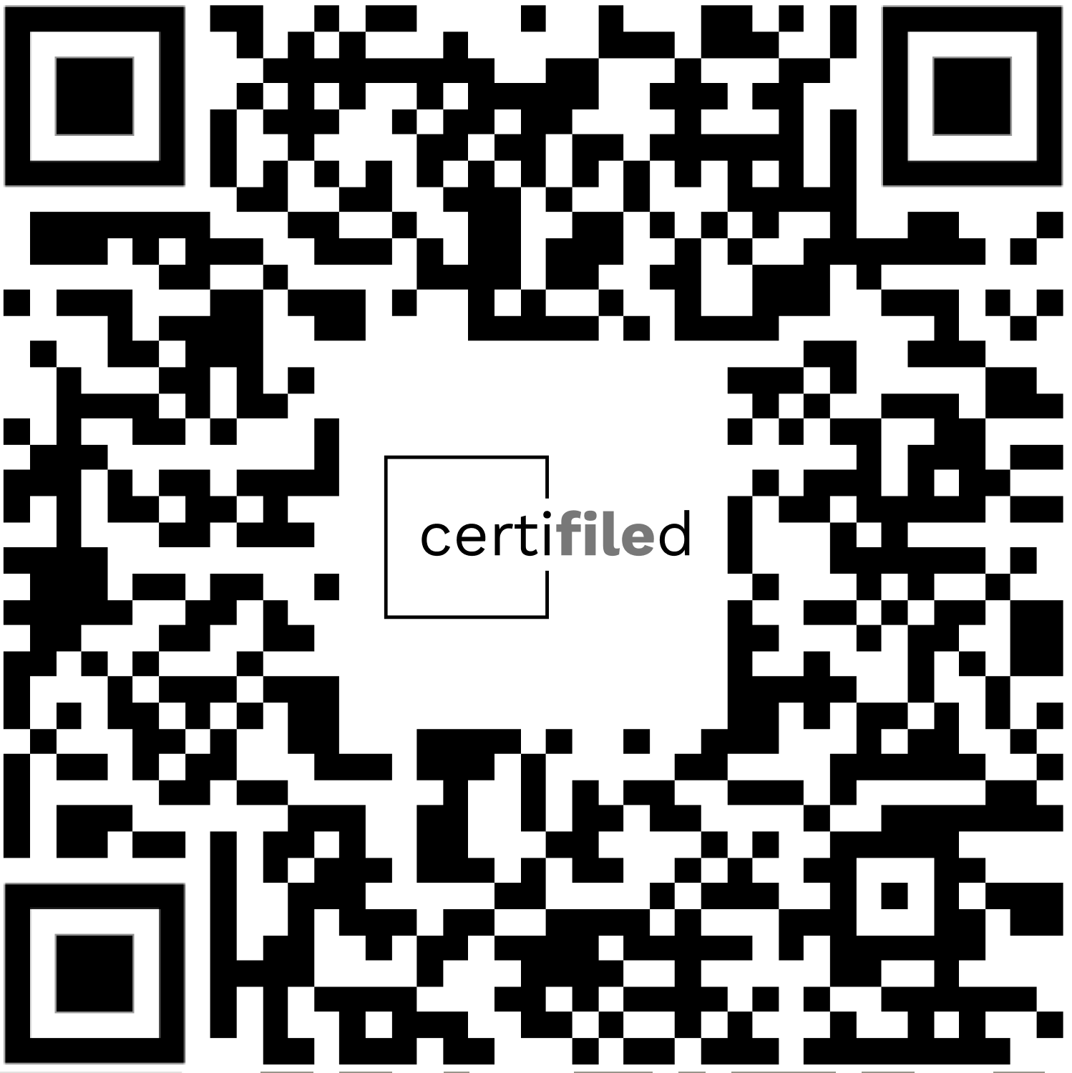
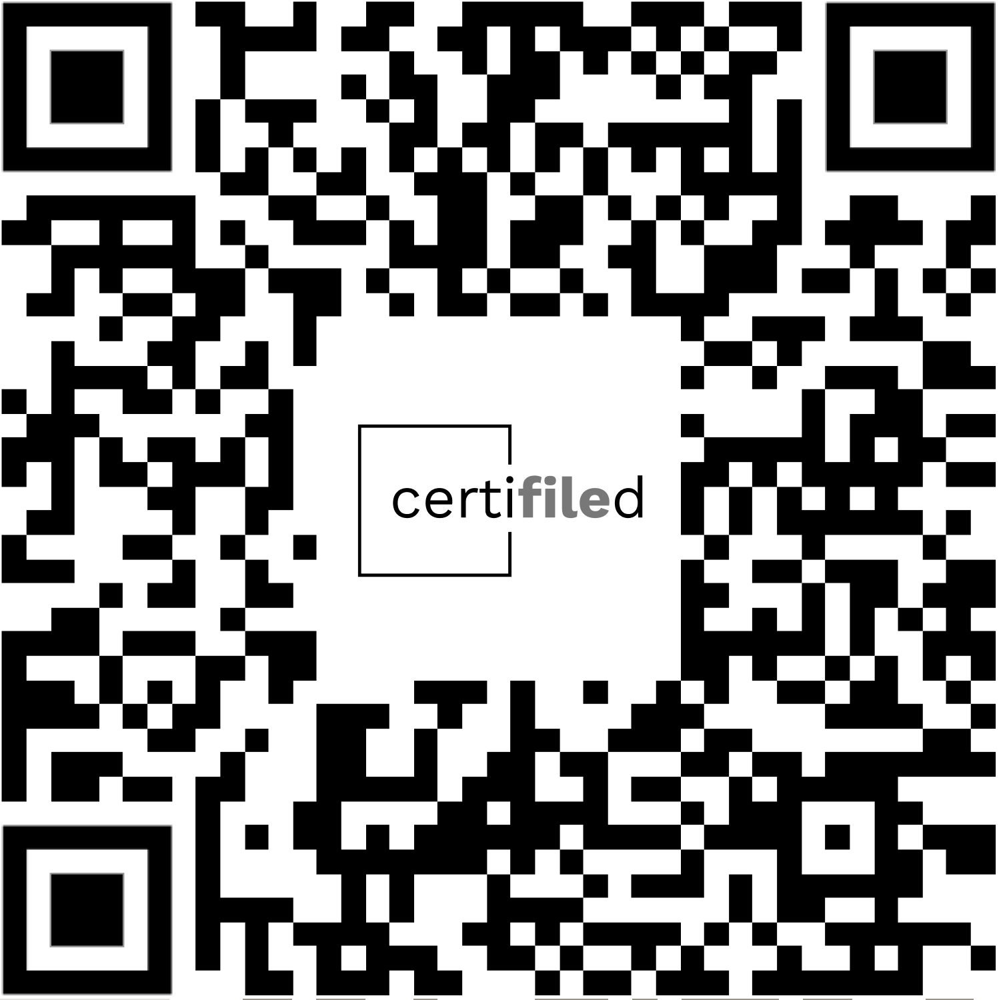

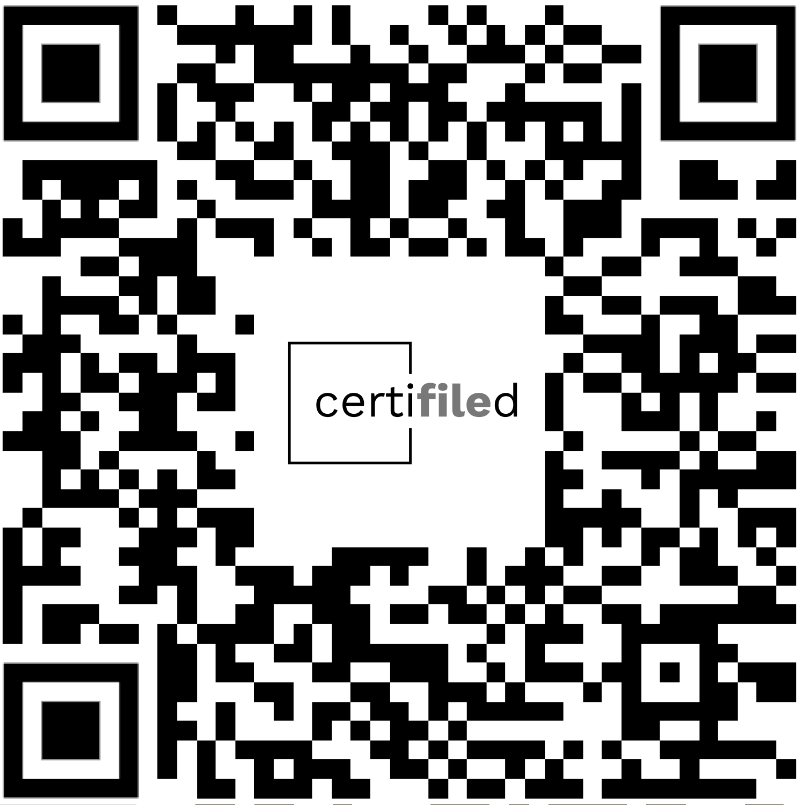
Go to certifiled.net
Thank
You

Slide 22
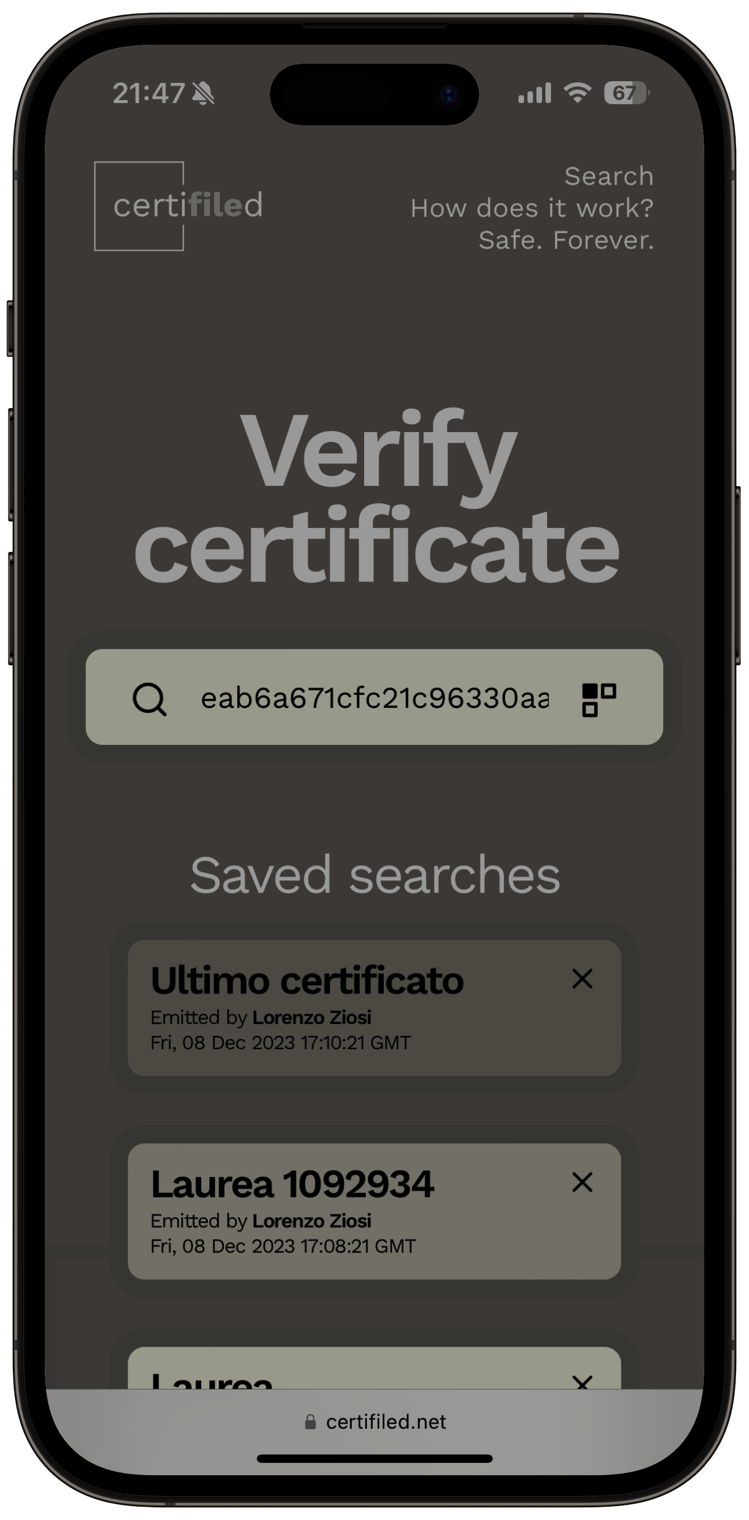
Go to certifiled.net
Thank
You

